Slide 1

Using the 2020 TENS Resources for Virtual Stewardship Campaigns
J. Davey Gerhard
Executive Director
The Episcopal Network for Stewardship

Slide 2

Faith-Filled Generosity
They are to do good, to be rich in good works, generous, and ready to share, thus storing up for themselves the treasure of a good foundation for the future, so that they may take hold of the life that really is life.
1 Timothy 6:18-19 NRSV
Taking “hold of the life that really is life” is something to which we all can aspire. That is a life filled with generosity based on our faith in a God who is generous in all things.
The TENS theme for 2020/21 is a call to each one of us to be “generous and ready to share” so that our ministries may be supported and our personal lives dedicated to the good work of the people of God.

Slide 3
Faith-Filled Generosity
What does this mean for us?
As we have moved through Matthew’s Gospel this year, we have heard how Jesus teaches us to be in relationship with each other and with God
Our relationship with God begins with the Creation, and our ongoing role in the re-creation of the world given to us by God
Such abundance inspires our generosity – we may give much because we have been given much

Slide 4
Faith-Filled Generosity
What is different about stewardship in 2020?
Communities are meeting virtually, some are hybrid
Economic fallout from the pandemic differs greatly by region, but is felt keenly in many faith communities
Uncertainty about what 2021 and recovery might bring

Slide 5
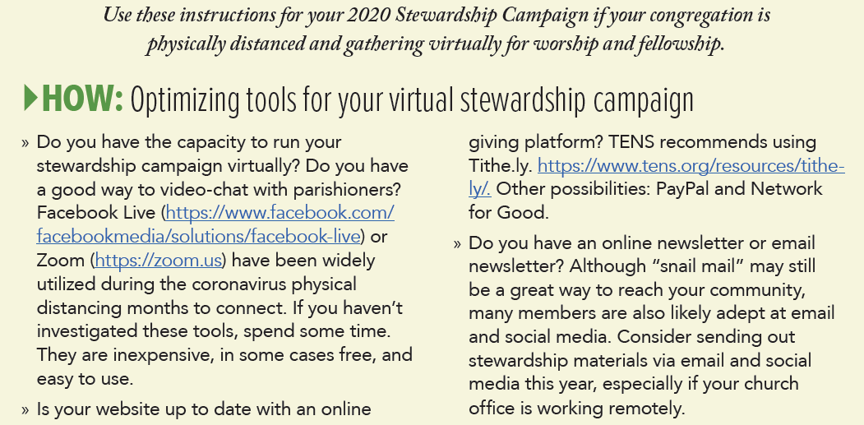
Guide for virtual stewardship
Choose your technology to gather virtually
Do your website, social media, streaming services, and newsletters offer ways to gather pledges and gifts online?
Have you looked at your newsletter format? Email is the primary way that many of us are communicating these days. Does your newsletter need a refresh?

Slide 6
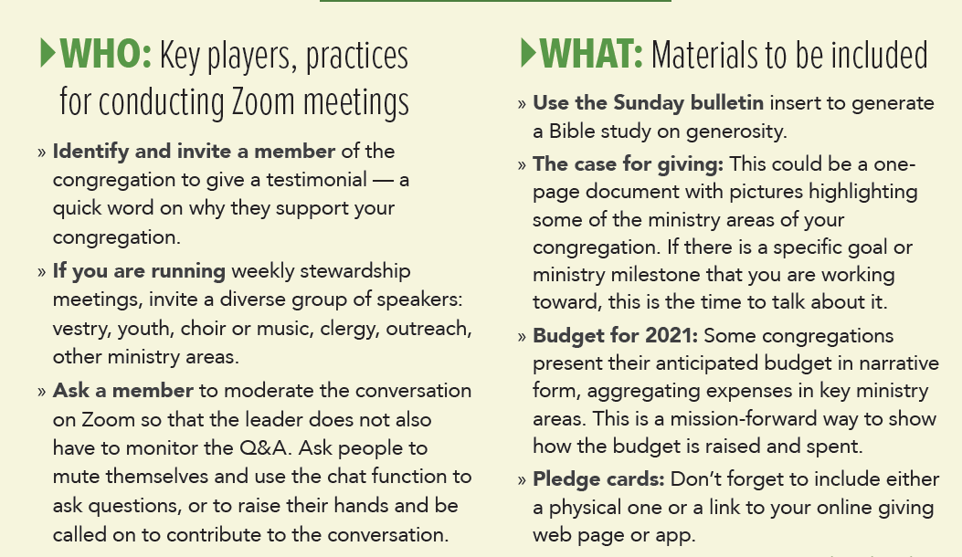
Guide for virtual stewardship
Gather testimonials from members – recorded videos, or other
Use small groups to teach generosity and develop community
What are your stewardship materials?

Slide 7
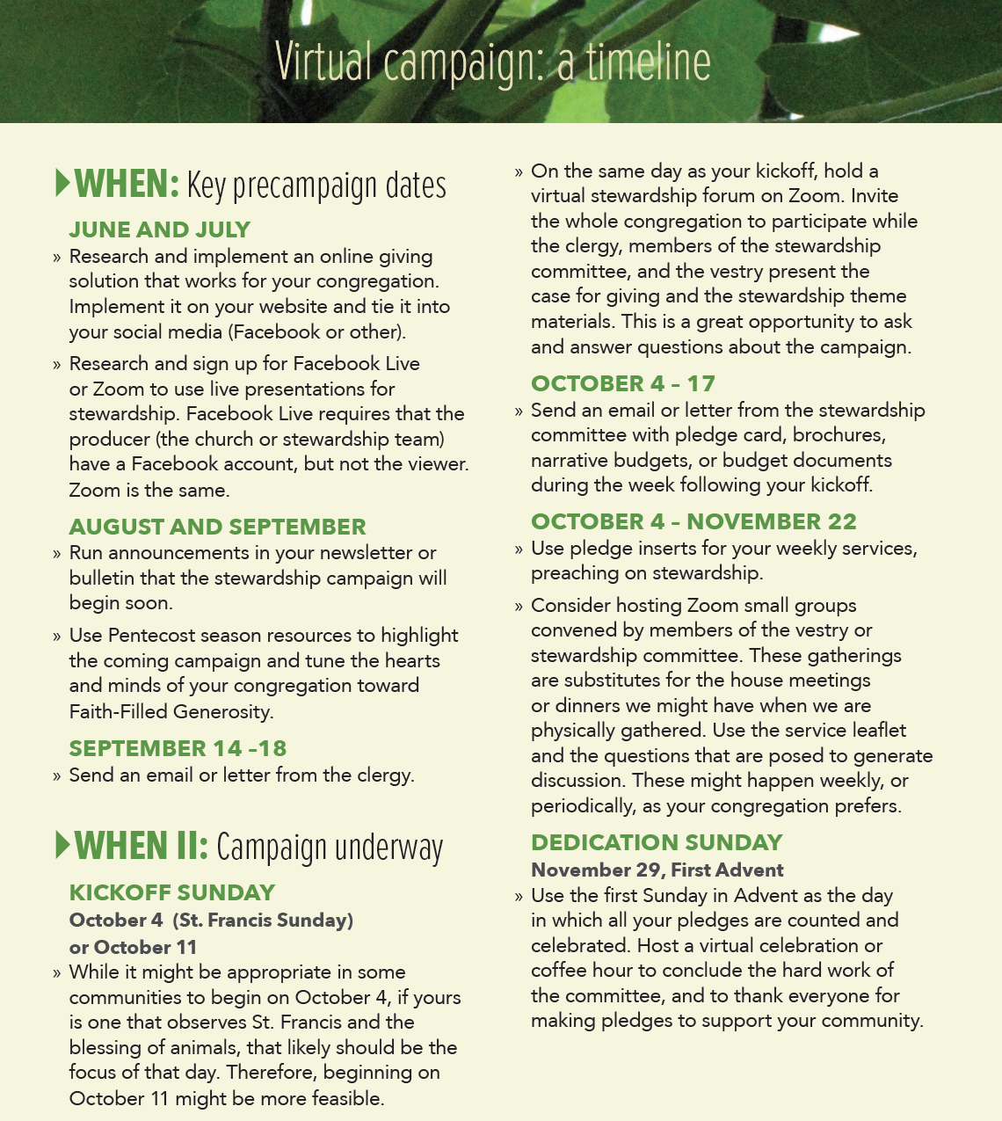
Timeline for virtual stewardship

Slide 8
New this year: Timeline for virtual stewardship
Pre-Campaign
Start early -- Everything takes longer in the pandemic
Research your technology -- test it
Build the hype
  Begin making announcements about the Faith-Filled Generosity theme
  Download our Introduction to Faith-Filled Generosity
Prepare theologically
  The July and August Pentecost reflections summarize the Gospels of those months, providing a stewardship framework for them and help congregations prepare the campaign to come
Drop your first letter from clergy beginning Sept 14-18 - give the mail time to be delivered. Also send in email

Slide 9
New this year: Timeline for virtual stewardship
During the Campaign
Kick-off Sunday
  Some communities will begin on October 4. If yours is one that highlights Francis on his feast day, it may be more appropriate to do your kick-off the following week, October 11
  After the principal service, hold a special virtual meeting to kick-off – introduce leadership, have a testimonial, review the campaign materials and case for giving
Oct 4-17 Send the next letter from either your wardens or your campaign chair along with your stewardship materials in post and in email
Weekly pledge-season inserts These will help you relate the readings each week to stewardship themes
Convene small groups however frequently your community can

Slide 10
New this year: Timeline for virtual stewardship
Dedication Sunday
Use the first Sunday in Advent to announce your pledge totals. Celebrate!
Pay special attention during the Offertory to hold up pledge cards, bless them, offer them to God for the work of the Church
Have a virtual coffee hour to celebrate the good work you have accomplished
  Thank campaign leadership
  Thank volunteers who have made testimonials or done other work for the campaign
  Remember the mission – talk about the great things that your congregation’s gifts will do for the community this year
Implement a follow-up plan to reach households who have not yet turned in their pledges

Slide 11
Why this year is different
How to talk about money when there is economic fallout from pandemic-related unemployment
There is no shame in a household pledging less this year than other years. Every gift matters.
Remember, some families are not struggling right now, so some of your members may be able to increase their giving
Every conversation about pledges is a pastoral one
We remember the Great Recession in 2008-2009. We recovered, and we will recover again. This too, shall pass.
Christians are people of Hope.
The work of the church is more acute in times of need

Slide 12
Why this year is different
How to talk about stewardship if your congregation is facing budget cuts, program cuts, or staff reduction
Keep your conversation focused on the mission
  The work of the church continues because the needs of our neighbors are still present.
  We may have fewer resources to spend on mission, so we find other ways to do the work of God
Did your congregation receive an SBA/PPP loan?
  Remind members that this insulated staff and programs from cuts for a period of time. Thank your staff and treasurer for completing the paperwork for these loans
There may be some members who can make extraordinary gifts to cover these unexpected shortfalls – ask them

Slide 13
Why this year is different
How to talk about stewardship in times of uncertainty
“Look at the birds of the air; they neither sow nor reap nor gather into barns, and yet your heavenly Father feeds them. Are you not of more value than they?” Matthew 6:26, NRSV
  Back in the season of Epiphany we heard this reminder
  Our times are often uncertain, it is our Christian hope and our prudent planning that can help us prepare and survive this uncertainty
  Pledges can be changed throughout the year if circumstances change – we are open and honest
  We can also make gifts from securities or other channels which may be performing better
The most important thing is to teach that all giving matters, regardless of the amount. Be prayerful.

Slide 14
Using the Weekly Inserts
Related to assigned readings for the week. Frame the readings for stewardship themes
Theological and practical statements of faith and generosity
They can be used in a post-service virtual coffee hour as a forum for discussion, or in a weekly small-group meeting
Each reflection suggests a couple of questions designed to engage us on stewardship topics
The reflections can also serve as inspiration for a sermon on stewardship

Slide 15
A Diversity of Voices
October 4 –The Rev. Ed Gomez, Vicar, Iglesia de San Pablo, Houston, Texas “Surrendering Privilege and Wealth”
October 11 – The Rev. Melanie S. Donohoe, Rector Epiphany Church, San Carlos, California “Living into New Ways of Being Church”
October 18 – The Rt. Rev. Diane Jardine Bruce, Bishop Suffragan, Diocese of Los Angeles “Give to God the Things that are God’s”
October 25 – Mr. Rob Townes, EVP Sinclair, Townes, & Company, Atlanta, Georgia “Freely Giving our All to God”
November 1 – Cn. Mary MacGregor, Retired Canon for Congregational Vitality and Mission Amplification, Diocese of Texas
“Lives Shaped by the Beatitudes”
November 8 – The Very Rev. Matthew Woodward, Dean of Trinity Cathedral, Sacramento, California “The Gifts of Faith”
November 15 – The Rev. Chris Harris, Associate Rector, Christ Church Cranbrook, Bloomfield Hills, Michigan “Risking our Lives to Find Them”
November 22 – Mr. J. Davey Gerhard, Executive Director of TENS, San Francisco, California “Where All are Queens and Kings”

Slide 16
Small Groups in Virtual Times
A powerful connection and deepening relationship is possible when members ask each other for their gifts or enter into dialogue about the mission and priorities of the church. Your stewardship campaign this year should create small groups focused on formation and mission. Small groups are the best way to develop meaningful formation about money and mission.
In times of physical distancing, small group meetings, led by members of the vestry, stewardship committee, or other lay leaders facilitate the education of mission and the teaching of good stewardship fundamentals.
Facilitated Small groups
House churches
Bible studies or topical studies

Slide 17
Small Groups in Virtual Times
Job description for a small-group leader
Committed to stewardship
  They have already made their own pledge
  Embrace the theme “Faith-Filled Generosity”
Know and believe in the case for giving
  Can answer questions about mission and ministry, or direct people to the answers
  Know the budget of the church, and can speak to it
Good listeners and facilitators
  Small groups are about intimacy and vulnerability and mutual support
Comfortable with technology
Available to host – we are all busy people. Make sure your hosts can give the time to do it right
How many small groups do you need?
Groups should have no more than 12 people to allow for connection and conversation
Each group should be able to meet at least three times during stewardship season

Slide 18
Small Groups in Virtual Times
TENS recommends that you have at least three small group
meetings this stewardship season
Kick-off: Walk through the stewardship materials, the case for giving, and the ministry. If there are pre-recorded testimonials or other accounts of the work your congregation is doing, show them. If there are questions about where the money goes, answer them. Ensure everyone has materials and pledge cards.
Bible Study: Picking one of the passages suggested in the upcoming slides, run a facilitated Bible study on a stewardship theme. Ask people to pray about their pledge.
Appreciative Inquiry: vision and mission. The last session should be about dreaming about the possible. We’ll look at this in more detail in a moment. This is where the invitation to pledge should come.

Slide 19
Small Group Bible Study Format
Opening Prayer: perhaps a prayer of thanksgiving or a prayer inviting the Holy Spirit to be present during the meeting and particularly the engaging scripture.
Ask someone to read the passage the first time.
  Group Conversation: What word, phrase, idea, or sentence stands out for you?
Ask a different person to read it a second time, perhaps from a different bible translation.
  Group Conversation: What is God/Jesus/this passage saying to you?
Ask a third person to read it, perhaps from yet another bible translation.
  Group Conversation: What is God/ Jesus/this passage calling you to do?
Close with prayer for each person, that each of you may become more and more the faithful, loving, generous stewards God calls us to be, that each of us may indeed respond to what God is calling us to do and to be.

Slide 20
Small Group Bible Studies on Stewardship
Genesis 1:27-28 We are made in God’s image
Psalm 30 The world belongs to the Lord and all that is in it
Malachi 3:7-12 Robbing God
Matthew 3:1-12 What does our baptism mean for us as stewards?
Matthew 5:1-12 The Beatitudes and stewardship
Matthew 6:7-14 Praying the prayer Jesus taught us as stewards
Matthew 25:14-30 The Parable of the Talents
Mark 4:21-25 A Lamp on a Stand
Mark 10:17-25 The Rich Young Man
Mark 12:41-44 The Widow’s Offering
Luke 12:13-34 The Parable of the Rich Fool
Luke 12:22-34 Where is your heart?
Luke 15:1-10 The Parables of the Lost Sheep and the Lost Coin
Luke 15:11-32 The Parable of the Lost Son
Luke 18:9-14 The Pharisee and the Tax Collector
Luke 18:18-27 The Rich Young Ruler
Luke 19:1-10 Zacchaeus
Luke 5:1-11, John 21:1-14 Two Fishing Stories
John 6:1-13 The Feeding of the 5,000
Colossians 3:12-17 Paul’s guidance for living lives as God’s Children
1 Peter 4:7-11 Stewards of the manifold grace of God
1 Timothy 6: 17-19 Be rich in good works
1Corinthians 4:1 God loves a cheerful giver.

Slide 21
Other Topics for Small Groups
Appreciative Inquiry is a model of design thinking or development that focuses on what is possible, what is good, what is exciting. It purposely does not ask negative questions or frame problems. It is a solutions-based, inclusive way to engage in respectful conversation.
What ministry of our congregation is most hopeful or most exciting to you? Why?
If money were no object, what service to our neighborhood / neighbors would you hope to begin? Why?
What are examples that you can name of nonprofits, organizations, or other churches that are doing remarkable work in our community? Why are they inspiring to you?
Which of your gifts are you most willing to share with our church? (some examples: music, accounting, website, answering the phone, yardwork, translation, invitation, having fun, leading groups, cooking food) Why?

Slide 22
Modeling Stewardship Dialogues: Making the ask
This year, we recommend that small-group hosts also extend the
invitation to pledge to their members.
Peer to peer asks are so powerful because they are authentic.
Develop a short and simple script around the core mission of the congregation – three to five talking points that can be shared
Write some questions for each group to answer as they gather
Ask each participant to review the materials they’ve received, pray about their giving, reflect on their household budget, and submit pledges by a due date.
Ask each participant one direct question: Will you support the mission of our church this year? Do not ask for the amount -- just a yes or a no.
Regardless of the answer, thank them for their time, and ask them to follow up with you (or the appropriate people) for more support or answers to questions they have.

Slide 23
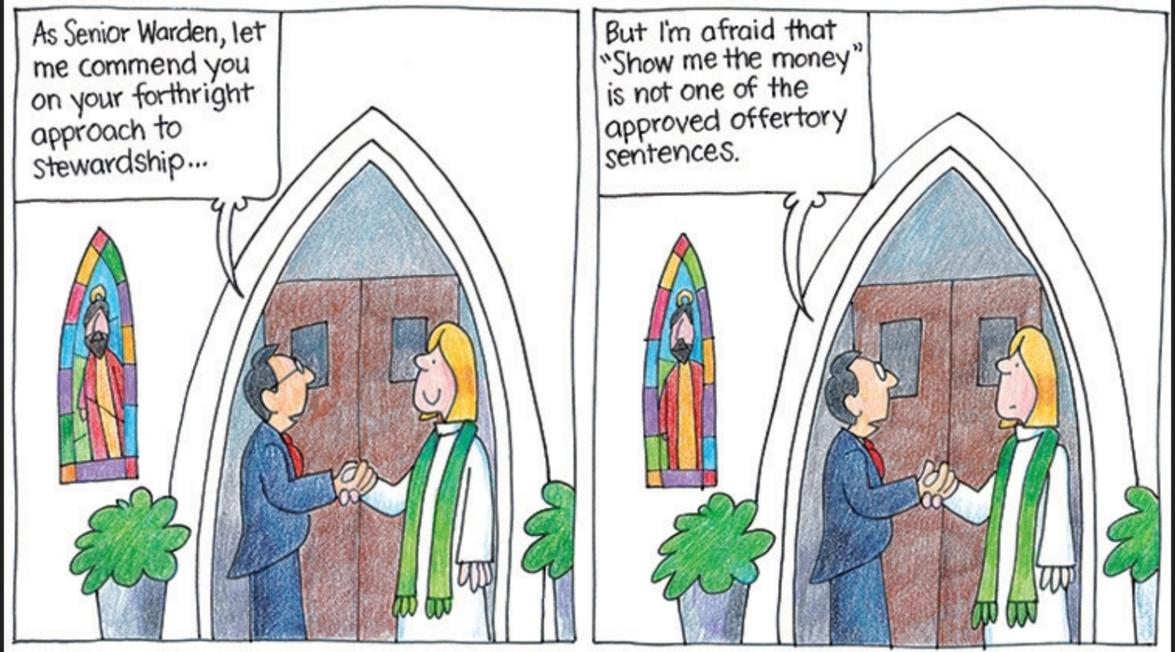
Liturgical Resources for your Virtual Stewardship Campaign
Cartoon by the Rev. Jay Sidebotham and the Church Pension Group

Slide 24
Liturgical Resources for your Virtual Stewardship Campaign
Best Practices for the Virtual Offertory
Invite: Use one of these alternate offertory sentences specifically developed for virtual gathering. These come from the Rev. Kay Sylvester, Rector of St. Paul’s, Tustin, CA
  Let us offer our gifts, so that God will bless and break them like holy bread, and use them to nourish the world.
  As Jesus fed thousands on a hillside from a small, shared meal, let our shared gifts multiply and bring God’s kingdom near.
  Creator God, gather our gifts from the four sacred directions as we give you thanks.
  Let us offer our gifts as seeds; may we plant and water them with God’s help; may God’s grace yield a harvest of new life.
  With grateful hearts, let us give what we have. With joyful hope, let us give for what can be.
  Let us love God and love one another by offering our gifts to the work of love.

Slide 25
Liturgical Resources for your Virtual Stewardship Campaign
Best Practices for the Virtual Offertory
Gather: In this moment, we take time to virtually pass the offering plate representing our gifts, hopes, and prayers to the Creator and our community. When gathered virtually, take the time to observe the solemnity of this moment
  Ask people gathered remotely to use this time to make their weekly pledge online
  Have a moment of silence for people to complete the action of online giving, or to give gratitude for what they have received
Bless: Making an action of Orans, bless the gifts that have been presented virtually by our members, give thanks
Break: Just as the gifts of bread and wine are broken and shared, so too our gifts of treasure, time, and talent are shared with a needful world. Take a moment to name the ministries supported by your congregation as a remembrance that our virtual work has very real impact in our world.

Slide 26
Your Questions or Comments
2020 resources https://www.tens.org/resources/member-resources/
Username: 1PETER
Password: FOUR:10
J. Davey Gerhard, Executive Director
415-869-7837 (o)
415-307-0172 (m)
davey@tens.org
http://www.tens.org
Notes:
26

